Slide 1
IIDEAS SoCal Conference 2018
CATEGORICAL VARIABLES
-ENCODING-
Cesar Acosta, PhD
Department of Industrial and Systems Engineering
University of Southern California

Slide 2
Numerical Categorical Predictors – EXAMPLE 2
Consider the following dataset
X₁ | X₂ | Y
S | -0.10 | 19.19
S | 2.53 | 22.74
S | 4.86 | 23.91
M | 0.26 | 7.07
M | 2.55 | 7.93
M | 4.87 | 8.93
L | 0.08 | 20.63
L | 2.62 | 23.46
L | 5.09 | 25.75
Notes:
Increase size of table numbers

Slide 3
Numerical Categorical Predictors – EXAMPLE 2
Consider the following dataset
X₁ | X₂ | Y
S | -0.10 | 19.19
S | 2.53 | 22.74
S | 4.86 | 23.91
M | 0.26 | 7.07
M | 2.55 | 7.93
M | 4.87 | 8.93
L | 0.08 | 20.63
L | 2.62 | 23.46
L | 5.09 | 25.75
X₁ | X₂ | Y
0 | -0.10 | 19.19
0 | 2.53 | 22.74
0 | 4.86 | 23.91
1 | 0.26 | 7.07
1 | 2.55 | 7.93
1 | 4.87 | 8.93
2 | 0.08 | 20.63
2 | 2.62 | 23.46
2 | 5.09 | 25.75

Slide 4
Numerical Categorical Predictors – EXAMPLE 2
X₁ and X₂ in the model as continuous variables
R² is close to 0.05, the explained variation of the response about the fitted equation is negligible
The Adjusted R-squared is negative and equal to -0.23632
Both predictors X₁ and X₂ seem not to be useful for predicting Y.
Coefficients:
Estimate Std. Error t value Pr(>|t|)
(Intercept) 15.1678 5.6816 2.670 0.037 *
x1 0.6019 3.4742 0.173 0.868
x2 0.7769 1.4275 0.544 0.606
Residual standard error: 8.505 on 6 degrees of freedom
Multiple R-squared: 0.05259, Adjusted R-squared: -0.2632
F-statistic: 0.1665 on 2 and 6 DF, p-value: 0.8504

Slide 5
Numerical Categorical Predictors – EXAMPLE 2
X₁ and X₂ in the model as continuous variables
Coefficients:
Estimate Std. Error t value Pr(>|t|)
(Intercept) 15.1678 5.6816 2.670 0.037 *
x1 0.6019 3.4742 0.173 0.868
x2 0.7769 1.4275 0.544 0.606
Residual standard error: 8.505 on 6 degrees of freedom
Multiple R-squared: 0.05259, Adjusted R-squared: -0.2632
F-statistic: 0.1665 on 2 and 6 DF, p-value: 0.8504

Slide 6

Numerical Categorical Predictors – EXAMPLE 2
The fitted plane is
$E\left[Y\right]=15.1678+0.6019 X1 −$0.7769 X2

Slide 7
Numerical Categorical Predictors – EXAMPLE 2
X₁ is substituted with indicator variables X₁₁ and X₁₂, as shown
X₁ | X₂ | Y
0 | -0.10 | 19.19
0 | 2.53 | 22.74
0 | 4.86 | 23.91
1 | 0.26 | 7.07
1 | 2.55 | 7.93
1 | 4.87 | 8.93
2 | 0.08 | 20.63
2 | 2.62 | 23.46
2 | 5.09 | 25.75
X₁₁ | X₁₂ | X₂ | Y
0 | 0 | -0.10 | 19.19
0 | 0 | 2.53 | 22.74
0 | 0 | 4.86 | 23.91
1 | 0 | 0.26 | 7.07
1 | 0 | 2.55 | 7.93
1 | 0 | 4.87 | 8.93
0 | 1 | 0.08 | 20.63
0 | 1 | 2.62 | 23.46
0 | 1 | 5.09 | 25.75

Slide 8
Numerical Categorical Predictors – EXAMPLE 2
Coefficients:
Estimate Std. Error t value Pr(>|t|)
(Intercept) 19.9650 0.5802 34.413 3.90e-07 ***
x11 -14.0760 0.6703 -20.998 4.54e-06 ***
x12 1.1974 0.6705 1.786 0.13418
x2 0.8155 0.1378 5.920 0.00196 **
Residual standard error: 0.8207 on 5 degrees of freedom
Multiple R-squared: 0.9926, Adjusted R-squared: 0.9882
F-statistic: 225 on 3 and 5 DF, p-value: 9.416e-06
These values show that the fitted model is highly significant.
The R-squared is very close to 1.
The set of two predictors explain 99.26% of the response variability. The adjusted R-squared is also high, being 0.988.
After validation this model can and should be used.

Slide 9
Numerical Categorical Predictors – EXAMPLE 2
Coefficients:
Estimate Std. Error t value Pr(>|t|)
(Intercept) 19.9650 0.5802 34.413 3.90e-07 ***
x11 -14.0760 0.6703 -20.998 4.54e-06 ***
x12 1.1974 0.6705 1.786 0.13418
x2 0.8155 0.1378 5.920 0.00196 **
Residual standard error: 0.8207 on 5 degrees of freedom
Multiple R-squared: 0.9926, Adjusted R-squared: 0.9882
F-statistic: 225 on 3 and 5 DF, p-value: 9.416e-06

Slide 10
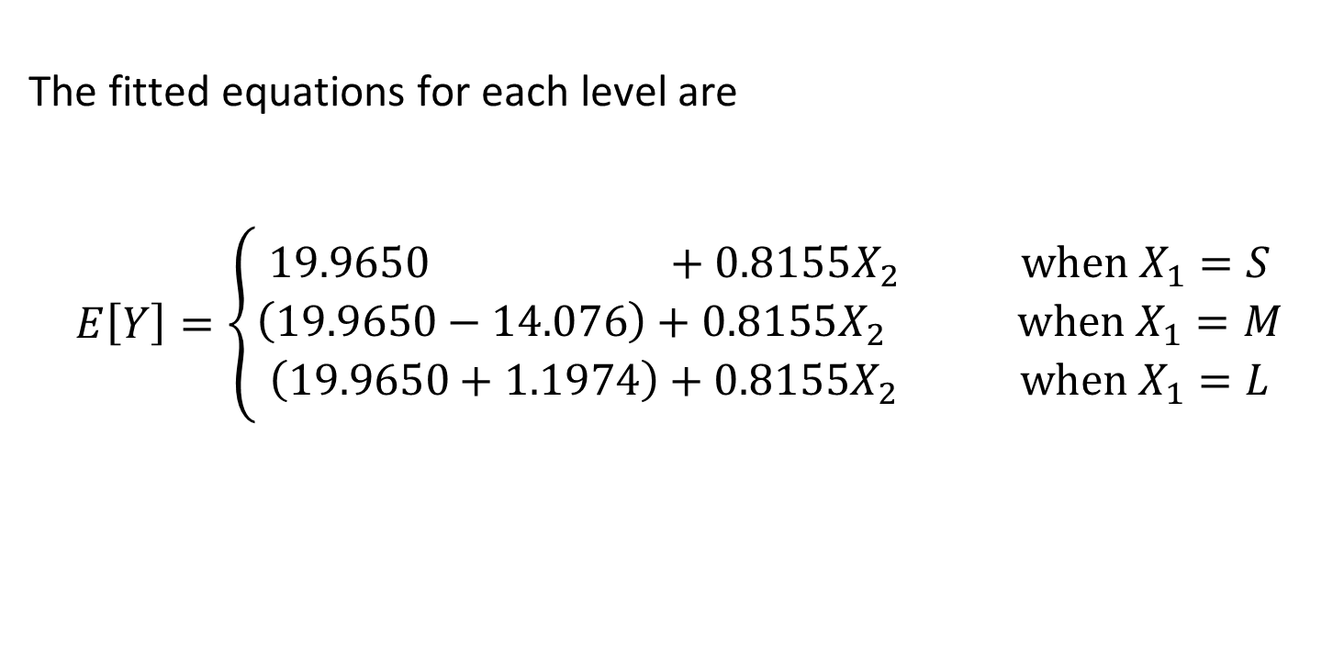
Numerical Categorical Predictors – EXAMPLE 2
The fitted equations for each level are
$$E\left[Y\right]=\left\{\begin{aligned}19.9650 +0.8155X_{2} when X_{1}=S \\ \left(19.9650−14.076\right)+0.8155X_{2} when X_{1}=M \\ \left(19.9650+1.1974\right)+0.8155X_{2} when X_{1}=L\end{aligned}\right.$$

Slide 11
Why are the models different?

Slide 12
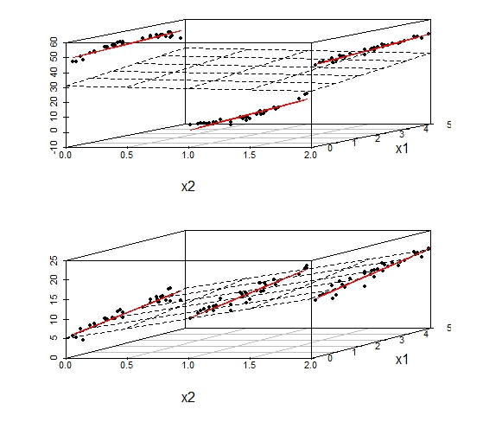
Why are the models different?
A fitted plane is found if both variables are included in the model as continuous.

Slide 13
Why are the models different?
A fitted plane is found if both variables are included in the model as continuous.
If X₂ is included in the model using indicator variables,
for each level j = 0, 1, 2,
a fitted equation is found.

Slide 14
Why are the models different?
The fitted lines may be away from the fitted plane
or
may be close to the fitted plane

